Slide 1




NEXT GEN EMPLOYABILITY PROGRAM
Creating a future-ready workforce
College Name
Student Name :Madhumitha.k
Student ID :72221205013
Park College of Engineering & Technology

Slide 2

CAPSTONE PROJECT SHOWCASE
Project Title
Notes Sharing Web Application using Django Framework
Abstract | Problem Statement | Project Overview | Proposed Solution | Technology Used | Modelling & Results | Conclusion

Slide 3
Abstract
In today's digital landscape, the demand for accessible educational resources is at an all-time high. This paper introduces a collaborative notes sharing web application aimed at addressing this need by enabling students to share academic materials seamlessly.
Developed using the Django framework, a Python-based web framework known for its efficiency and practical design, this application provides a robust platform for users to share, download, and upload notes in various formats.
The system architecture, based on Django's Model-View-Template (MVT) architecture, ensures scalability, maintainability, and a clear separation of components.
Key features include user authentication, file management, a search function for easy access to specific materials, and a categorization system for organizing notes by subject or course. Initial testing suggests a positive response from users, indicating the potential of the application to enhance collaborative learning and resource sharing.
Future enhancements may include collaborative editing, integration with cloud storage, and the use of machine learning for personalized content recommendations.
Source :Gpt 4

Slide 4
Problem Statement
One of the key issues this project tackles is the absence of an intuitive, effective, and collaborative platform tailored for the sharing and organization of academic notes and resources among students and educators. While there are several online platforms available, there exists a noticeable gap in services specifically designed for academic collaboration. Many students currently rely on disjointed and potentially insecure methods to share study materials. The objective here is to utilize the Django framework to create a secure, scalable, and user-friendly web application. This platform aims not only to simplify the sharing and management of notes but also to elevate the learning experience through collaborative tools and a community-driven approach.
Source :

Slide 5
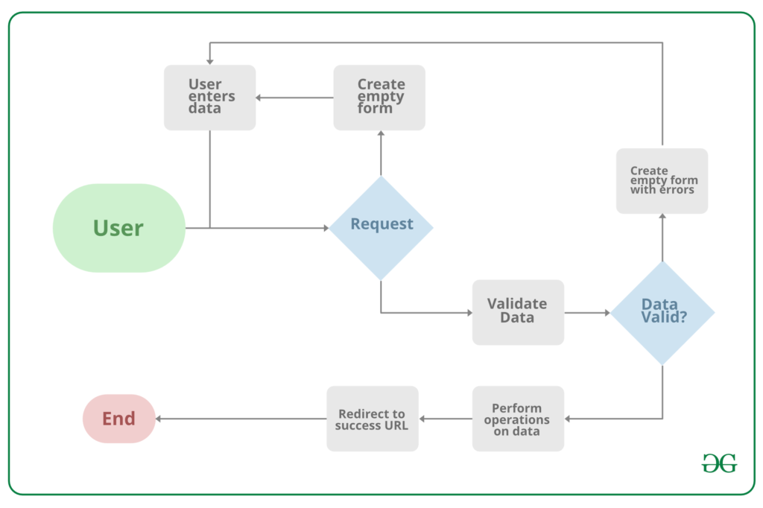
Project Overview
Source :google

Slide 6
Proposed Solution
The proposed solution entails the development of a comprehensive Notes Sharing Web Application, prioritizing security, usability, and inclusivity for students, educators, and academic institutions. Harnessing the robustness and scalability of the Django framework, the solution will comprise several
key components:
1. System Architecture: Utilizing Django for backend operations such as server-side logic, database management, and user authentication to ensure a robust and secure foundation. Frontend integration will involve HTML, CSS, and JavaScript alongside Django’s template system to craft an intuitive and responsive user interface.
2. Database Design: Employing a relational database schema to efficiently store user data, notes, categories, and interactions, facilitating seamless data retrieval and secure storage.
3. Core Features: Implementing user authentication and authorization mechanisms using Django’s built-in system to manage accounts and ensure data privacy. Additionally, enabling users to upload, download, and manage notes in various formats with collaborative tools like commenting, rating, and discussion features to foster a collaborative learning environment.
.
Source : GPT 4

Slide 7
3. Security and Privacy
Implement Django’s security best practices to protect against common vulnerabilities such as SQL injection, Cross-Site Scripting (XSS), and Cross-Site Request Forgery (CSRF).
Ensure data privacy by adhering to regulations such as GDPR for the handling of personal information.
4. Scalability and Performance
Design the application with scalability in mind, allowing for easy adaptation to increased user numbers and data volume without performance degradation.
Utilize Django’s caching framework to enhance application performance and reduce server load.
5. User Experience (UX) Design
Follow a user-centered design approach to create an accessible and engaging platform, ensuring that the UI/UX caters to the needs and preferences of the target audience.
Implement responsive design principles to ensure the application is accessible across various devices and screen sizes.
6. Testing and Quality Assurance
Conduct thorough testing, including unit tests, integration tests, and user acceptance testing (UAT), to ensure the application is reliable, secure, and user-friendly.
Utilize Django’s testing framework to automate test cases and ensure code integrity.
Source :GPT 4

Slide 8


Technology Used
Front-end
Back-end
Source :

Slide 9
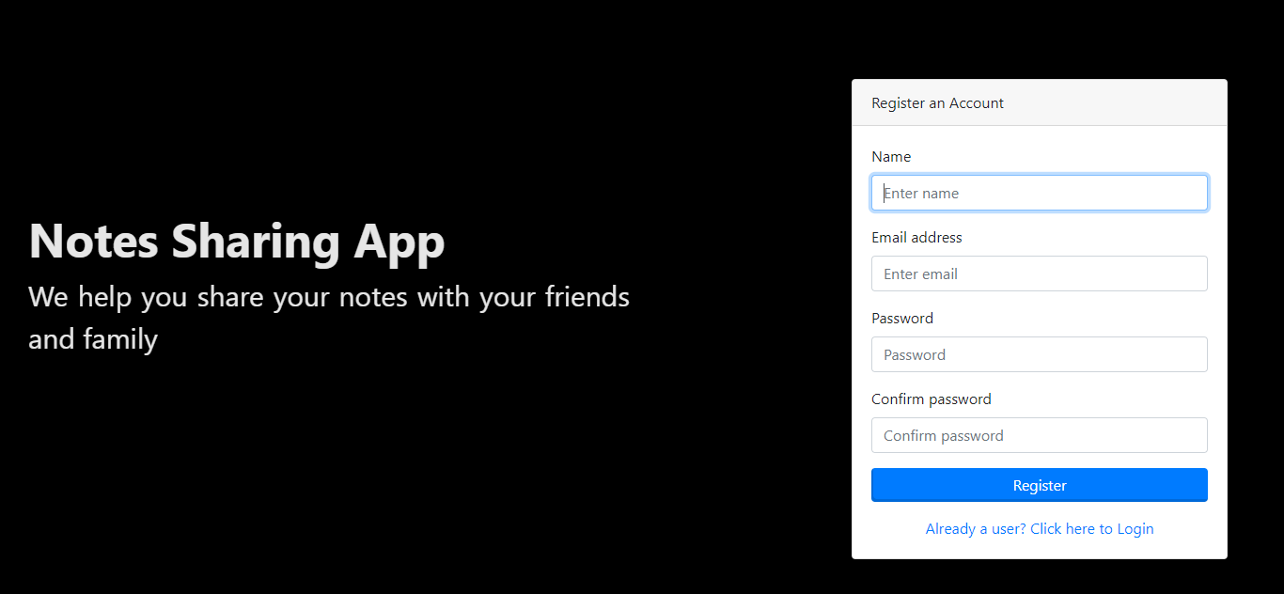
Modelling & Results
Source :

Slide 10
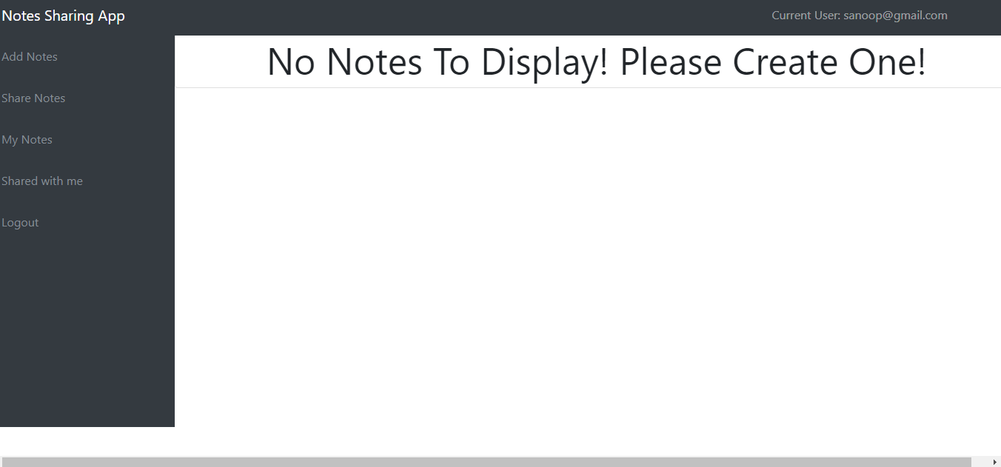
User-Profile

Slide 11
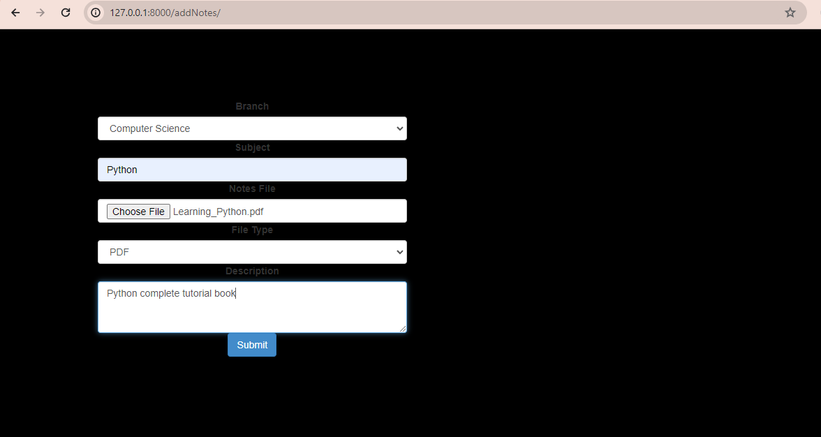
User-Profile

Slide 12
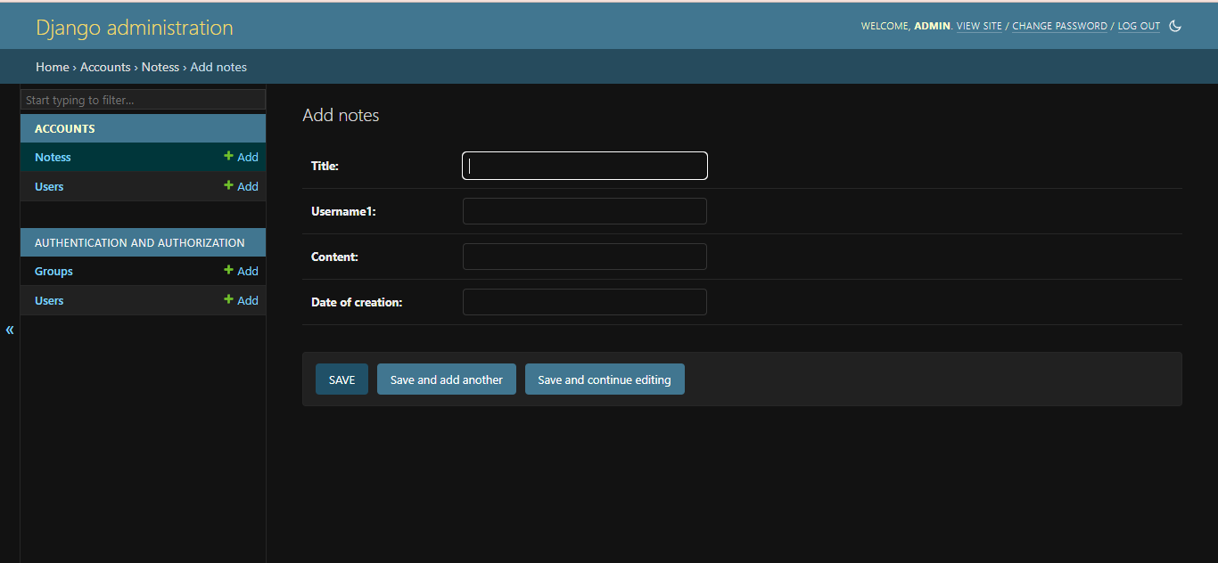
Admin-Page

Slide 13
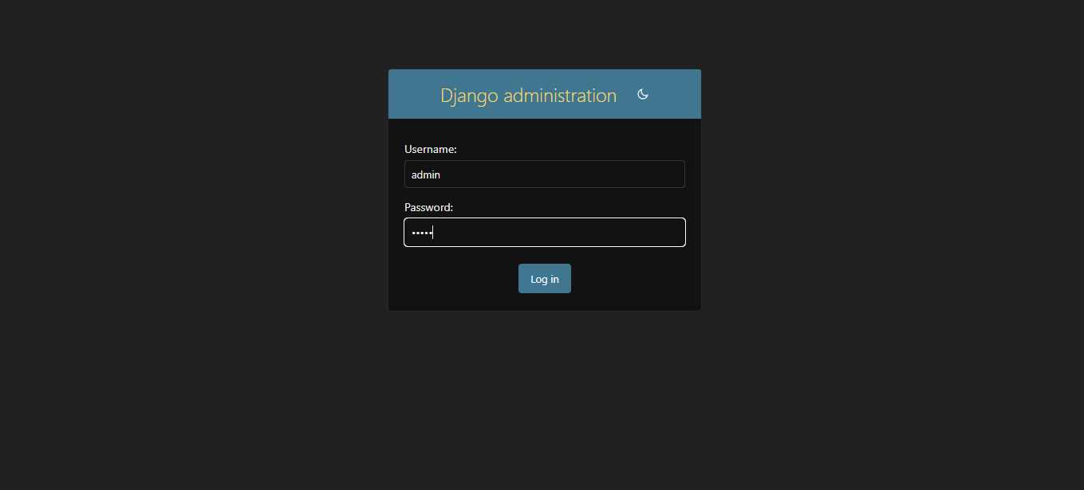
Departments-Page

Slide 14
Future Enhancements:
1. Artificial Intelligence and Machine Learning Integration
To enhance user experience, the application will integrate cutting-edge AI and machine learning algorithms. A Content Recommendation System will be developed, leveraging user behavior analysis to offer personalized note suggestions. Additionally, Natural Language Processing (NLP) techniques will be employed for Automatic Categorization, streamlining note organization based on content for efficient uploads and improved resource discovery.
2. Enhanced Collaboration Features
The application will introduce innovative collaboration tools for seamless teamwork. Real-Time Collaboration functionalities, akin to Google Docs, will enable simultaneous editing and commenting on documents. Study Groups will be facilitated within the app, empowering users to create and join study groups for a more organized and collaborative learning environment.
3. Integration with External Platforms
Users will benefit from seamless integration with popular cloud storage services like Google Drive and Dropbox for effortless note uploads and backups. Furthermore, the application will integrate with diverse educational tools and platforms, offering users a consolidated hub to access an array of educational resources and tools within a single interface.

Slide 15
Conclusion
In conclusion, note sharing applications represent invaluable tools for fostering collaboration, knowledge exchange, and organization across various domains. Whether utilized for educational, professional, or personal purposes, these platforms offer a centralized space for users to create, share, and collaborate on notes. By facilitating efficient communication, enhancing productivity, and fostering learning and growth, note sharing applications empower individuals, teams, and communities to connect and succeed in the digital age. As technology evolves, the importance and impact of these applications are expected to increase, providing vital support for collaboration and knowledge sharing in diverse contexts.
Source :

Slide 16
Thank You!
Notes:
Thank You !!

